Slide 1
COLLEGE ADMISSION AGENT
CAPSTONE PROJECT
Presented By:
Student name : KOLIMI HEENA KOUSAR
College Name & Department : MADANAPALLE INSTITUTE OF TECHNOLOGY AND SCIENCE – CSE

Slide 2
OUTLINE
Problem Statement
Technology used
Wow factor
End users
Result
Conclusion
Git-hub Link
Future scope
IBM Certifications

Slide 3
Problem Statement
Applicants seeking college admissions face challenges such as :
Accessing accurate information about eligibility, fees, courses, and deadlines
Delayed communication and inconsistent answers from admission offices
There is a strong need for a reliable, automated solution to assist prospective students and parents with all admission-related queries.
Proposed Solution:
A conversational AI-based College Admission Agent powered by Retrieval-Augmented Generation (RAG) and IBM Cloud technologies. It instantly answers questions about courses, eligibility, fees, important dates, and more — 24/7, using a dynamic knowledge base.

Slide 4
Technology used
IBM cloud lite services
Natural Language Processing (NLP)
Retrieval Augmented Generation (RAG)
IBM Granite Foundation model

Slide 5
IBM cloud services used
IBM Cloud Watsonx AI Studio
IBM Cloud Watsonx AI runtime
IBM Cloud Agent Lab
IBM Granite foundation model

Slide 6
Wow factors
College Admission Agent acts as a virtual admissions officer:
Answers admission queries in real-time and natural language
Always updated with new courses, fees, policies (via document ingestion)
Reduces manual workload for college staff
Can be used anytime, anywhere by students and parents
Example:
User: “What is the eligibility for B.Tech in CSE?”
Agent: “You need a minimum of 60% in PCM in 12th Grade to be eligible for B.Tech CSE.”

Slide 7
End users
Prospective Students (UG and PG)
Parents & Guardians
College Admission Officers
Academic Counselors

Slide 8
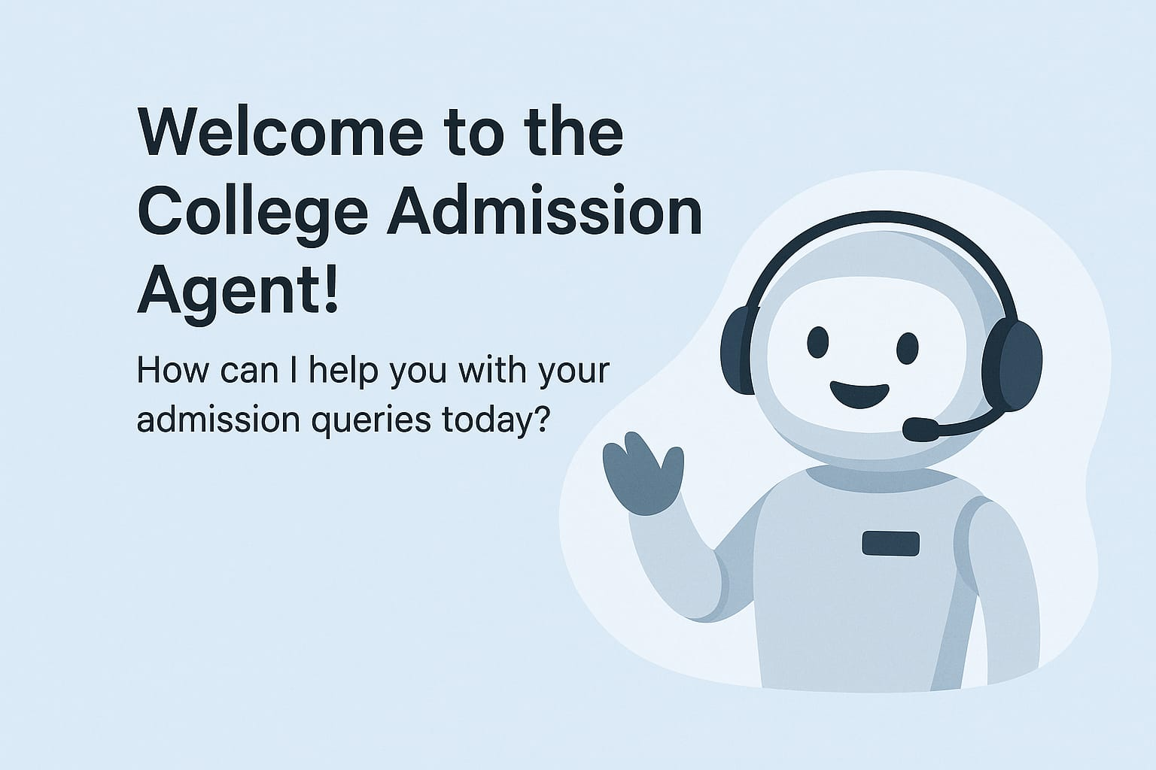
Results

Slide 9
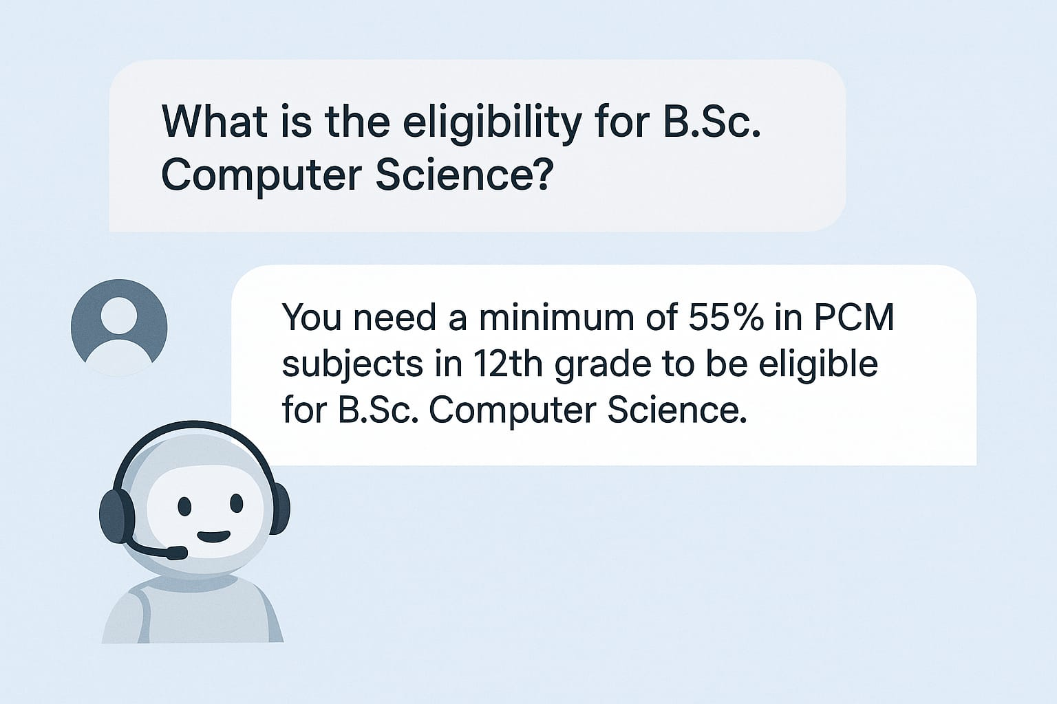
Results

Slide 10
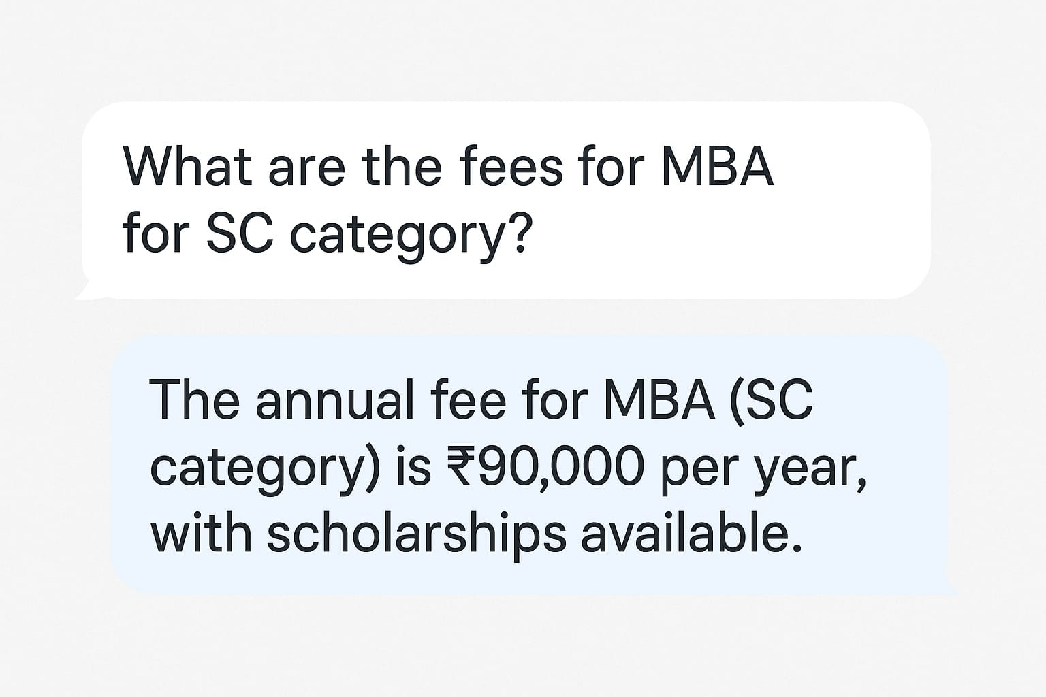
Results

Slide 11
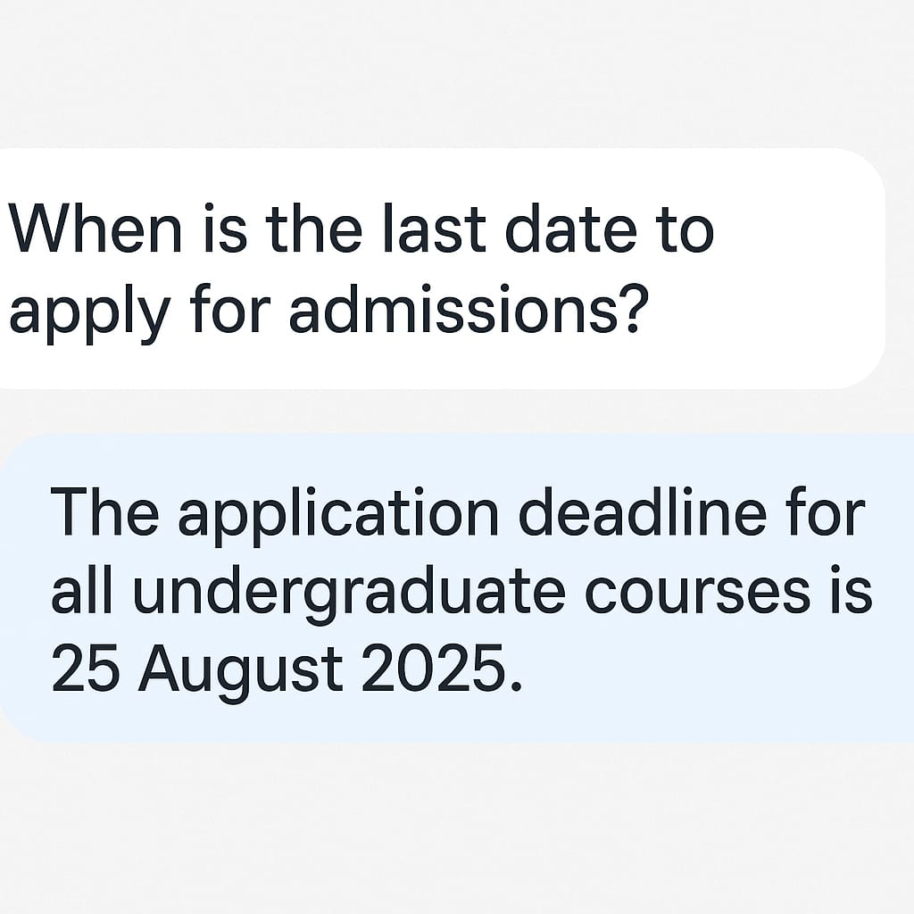
Results

Slide 12
Conclusion
Automates the repetitive aspects of admission advice
Ensures consistent, accurate, 24/7 support
Easily expandable to cover more queries (hostel, placements, counseling, etc.)
Practical example of RAG-based AI in the education sector

Slide 13
Future scope
Add support for multiple languages (Hindi, Tamil, etc.)
Voice-enabled/WhatsApp/Telegram integration
Automated document upload & admission status tracking
Analytics dashboard for popular queries and trends

Slide 14
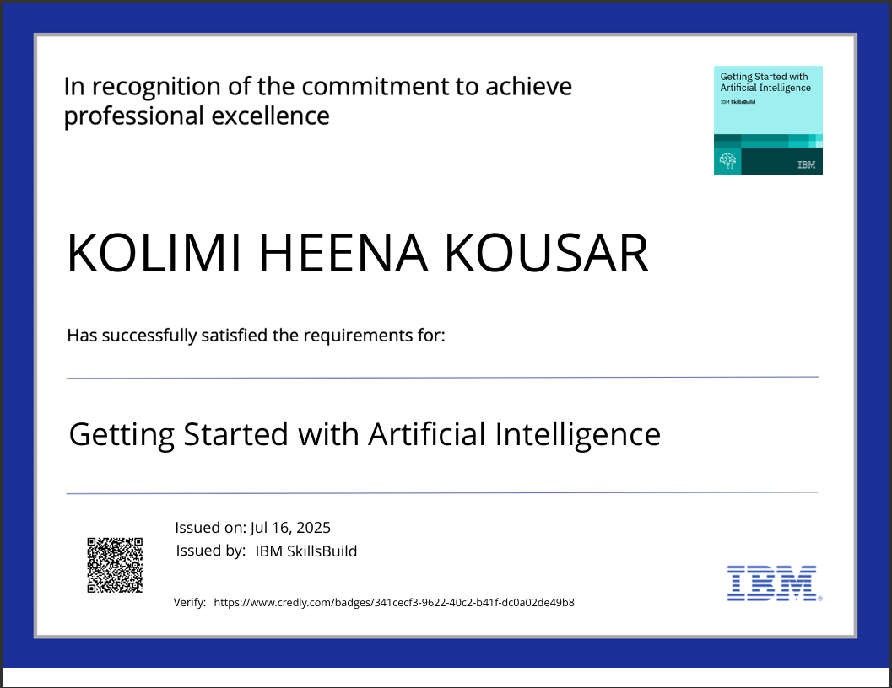
IBM Certifications

Slide 15
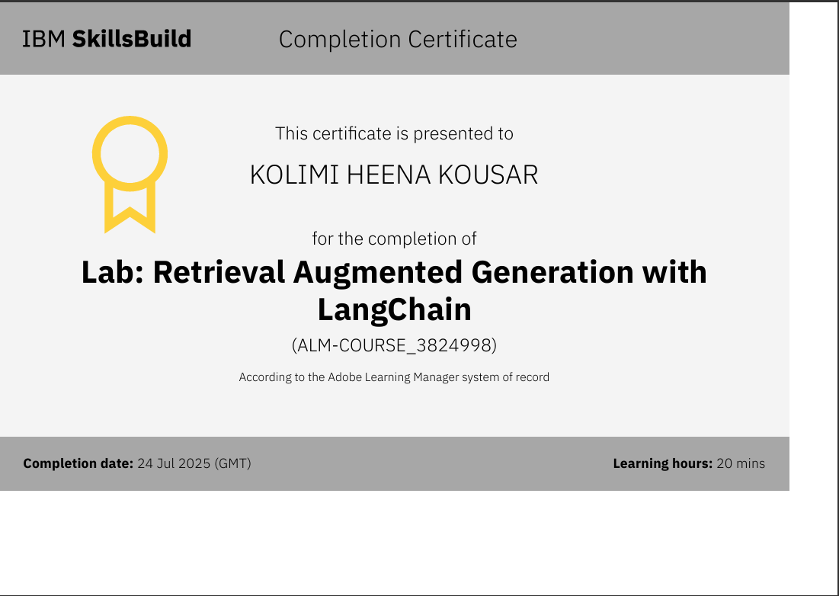

Slide 16
Git hub link : https://github.com/Heenakousar26

Slide 17
GitHub Link
Make sure that there should be readme file

Slide 18
THANK YOU

